Slide 1
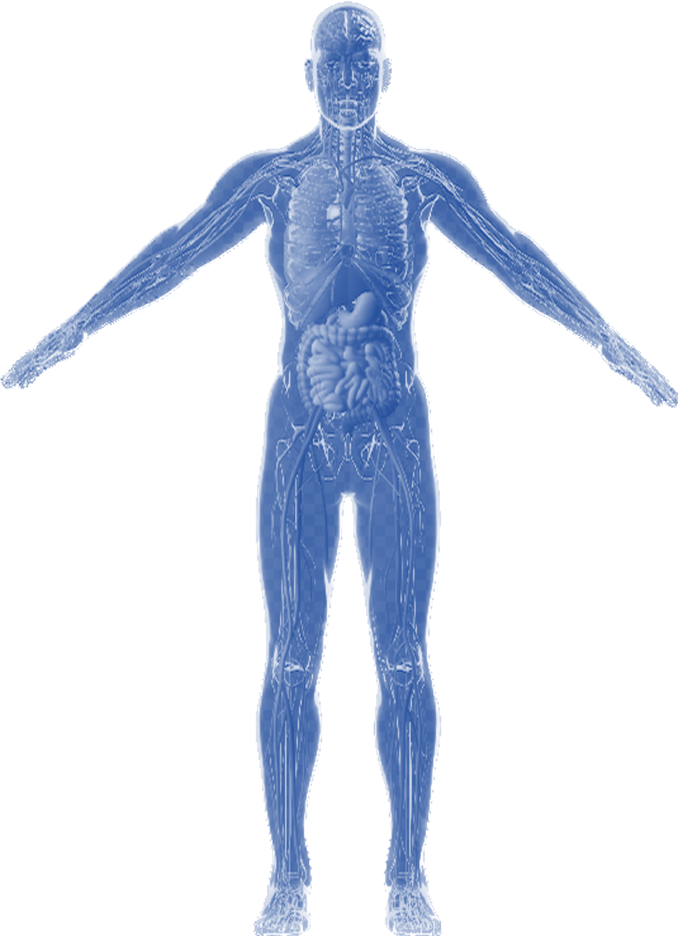
Ideathon: Using AI to Build a Digital Twin
Team-01
Notes:
Solid color BG

Slide 2


Overview of Problem
Digital twin will be a modality for NCD intervention. Non-communicable diseases are causing 78% of deaths in Saudi Arabia ^{[1]} Citizens have 16.4% probability of dying from NCD. ^{[2]} prevalences' in Saudi Arabia are:
Causes
Prevalence
16.4%
Diabetes, 40% of them with uncontrolled glucose levels. ^{[1]}
Lack of health education programs. ^{[4]}
32.6%
Diseases are not being detected early. ^{[5]}
Prevalence of Hypertension.
54%
Prevalence of High Cholesterol Levels. ^{[4]}
Poor diet and low level of physical activities (40% in men, 75% in women).^{[2]}
Diseases are not being detected early. ^{[5]}
Notes:
Mahmood FM. Prevalence and prevention of lifestyle-related diseases in Saudi Arabia. Int J Health Sci (Qassim). 2018 Sep-Oct;12(5):1-2. PMID: 30202400; PMCID: PMC6124832.
World Health Organization (WHO). Global Health Estimates 2016:Deaths by Cause, Age, Sex, by Country and by Region, 2000–2016. Geneva: WHO; 2016
Sulaiman A. Alshammari, Abdullah S. Alshammari, Hotoon S. Alshammari, Shaik S. Ahamed
Saudi Medical Journal Oct 2023, 44 (10) 951-964; DOI: 10.15537/smj.2023.44.10.20230178
Al-Nozha MM, Arafah MR, Al-Maatouq MA, Khalil MZ, Khan NB, Al-Marzouki K, Al-Mazrou YY, Abdullah M, Al-Khadra A, Al-Harthi SS, Al-Shahid MS, Al-Mobeireek A, Nouh MS. Hyperlipidemia in Saudi Arabia. Saudi Med J. 2008 Feb;29(2):282-7. PMID: 18246242.
Cancer saudi arabia 2020 country profile (no date) World Health Organization. Available at: https://www.who.int/publications/m/item/cancer-sau-2020 (Accessed: 01 November 2023).

Slide 3
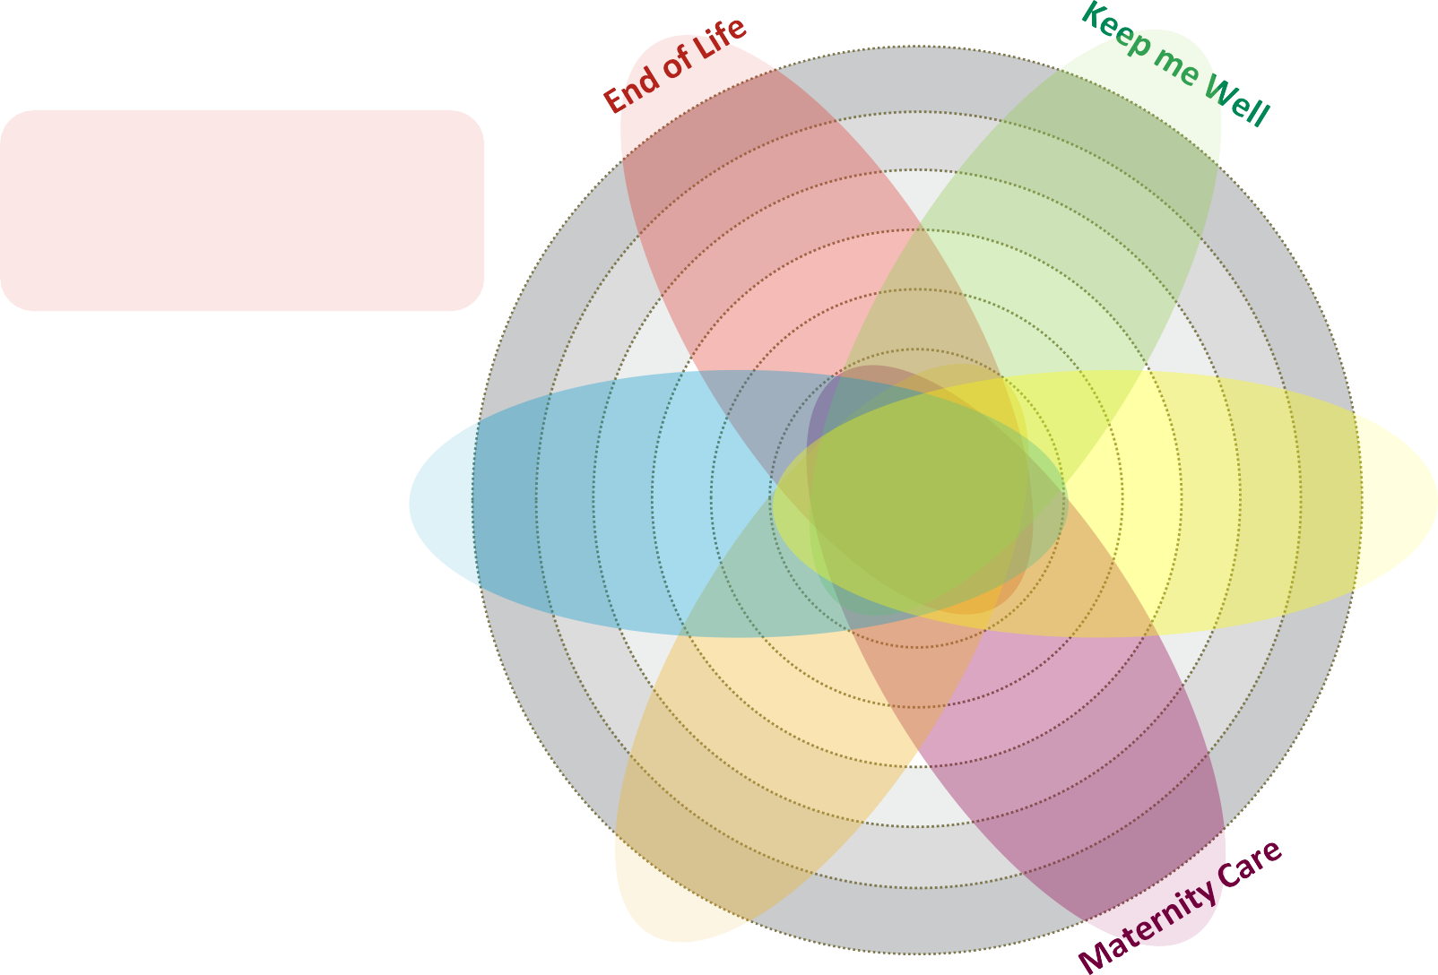
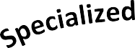


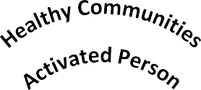


The Need for Digital Twin in Healthcare
How Can Digital Twin Support The Model Of Care?
Definition:
A digital twin is a virtual presence representing a physical entity through data modeling, sensors, and artificial intelligence systems.
Chronic Care
Planned Care
The Model of Care

Slide 4






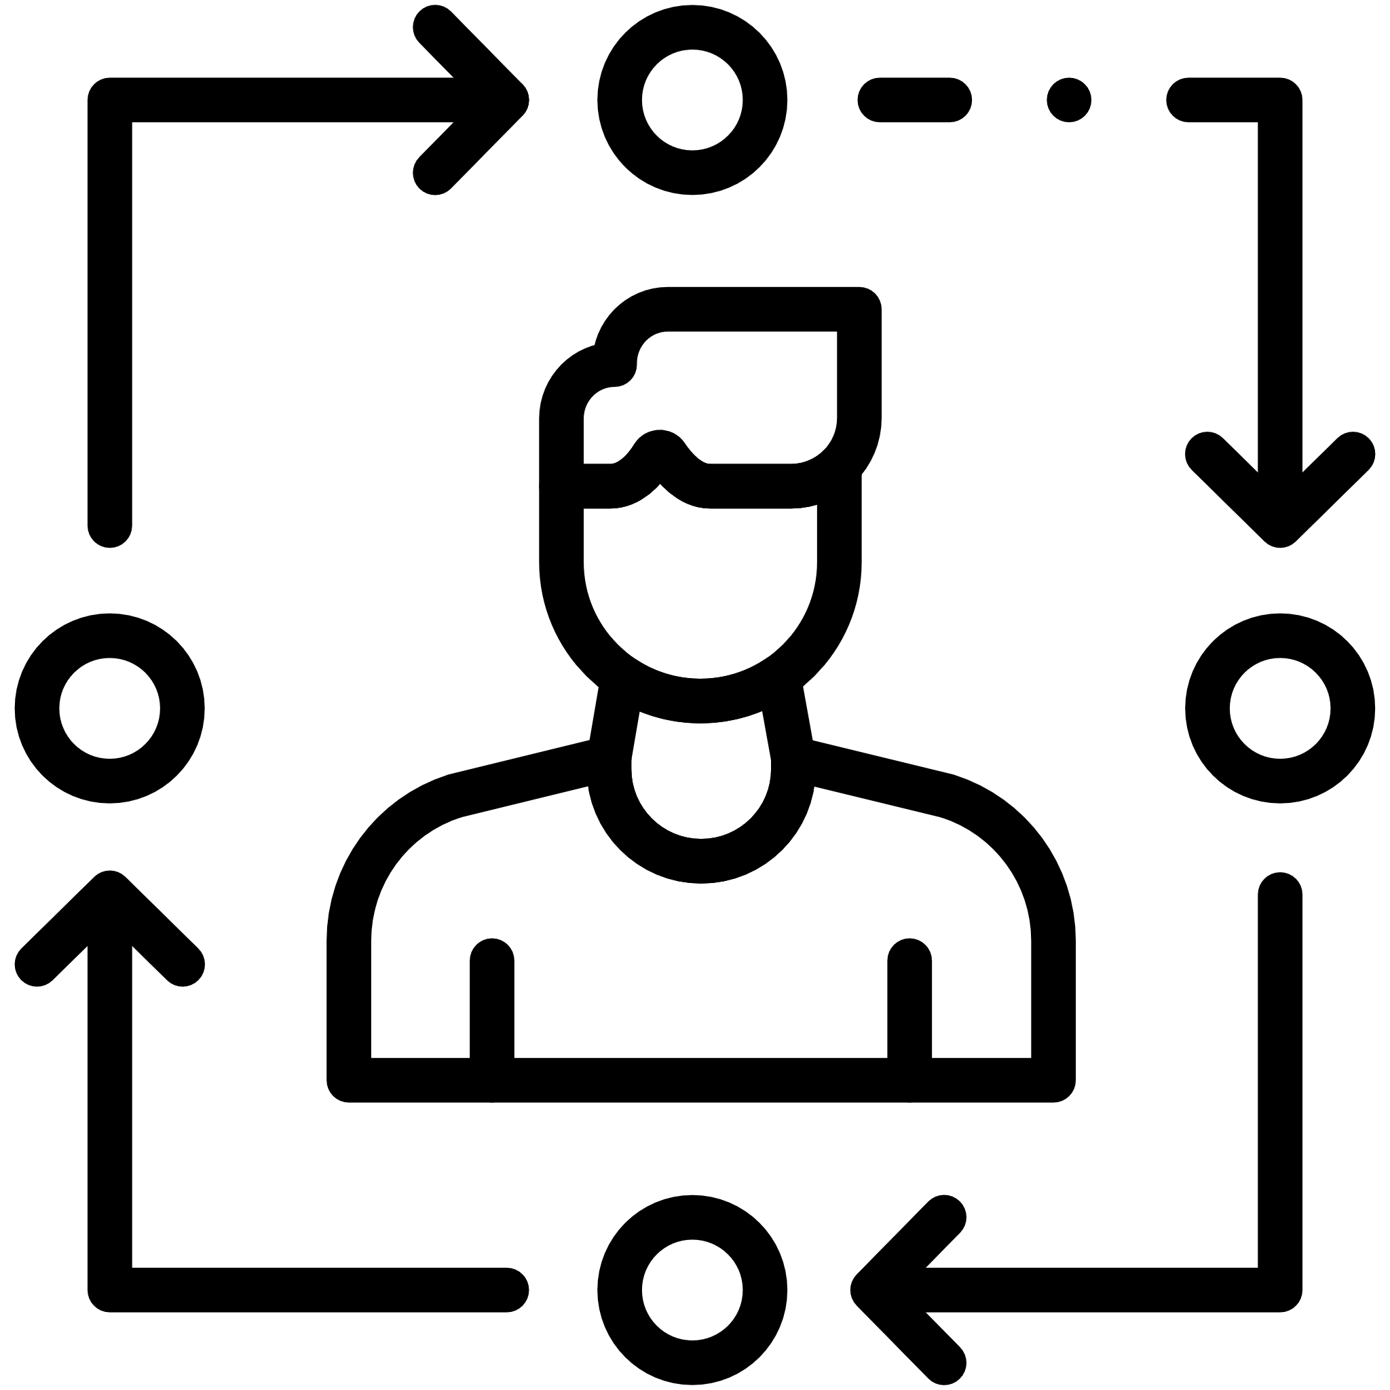

AI Use Case: The Digital Twin Project
Digital Twin
Aims to:
Provide preventive measures Through early identification of diseases.
Establish recommendations to mitigate onset of high-risk diseases.
Provide personalized health management plans to individuals based on their data
Provide real time analysis of individuals’ health related data (physical activity, vital signs and monitoring devices)
Provide recommendations based on individuals’ behavior
Definition
Enablers
AI Solutions
Recommendation Systems
Simulation Models
IoT
Patient Data from various sources
Medical Knowledge Base
Clinical Pathways
Genomic testing
Clinical Application
Notification and awareness
Early detection
Digital clinical pathway
Vital signs
Medical decision support
Disease prognosis
personalized Medications
personalized recommendations
Notes:
Journey of digital twin:
- Phase 1
→Objectives
Channels
Demo?
- Phase 2

Slide 5
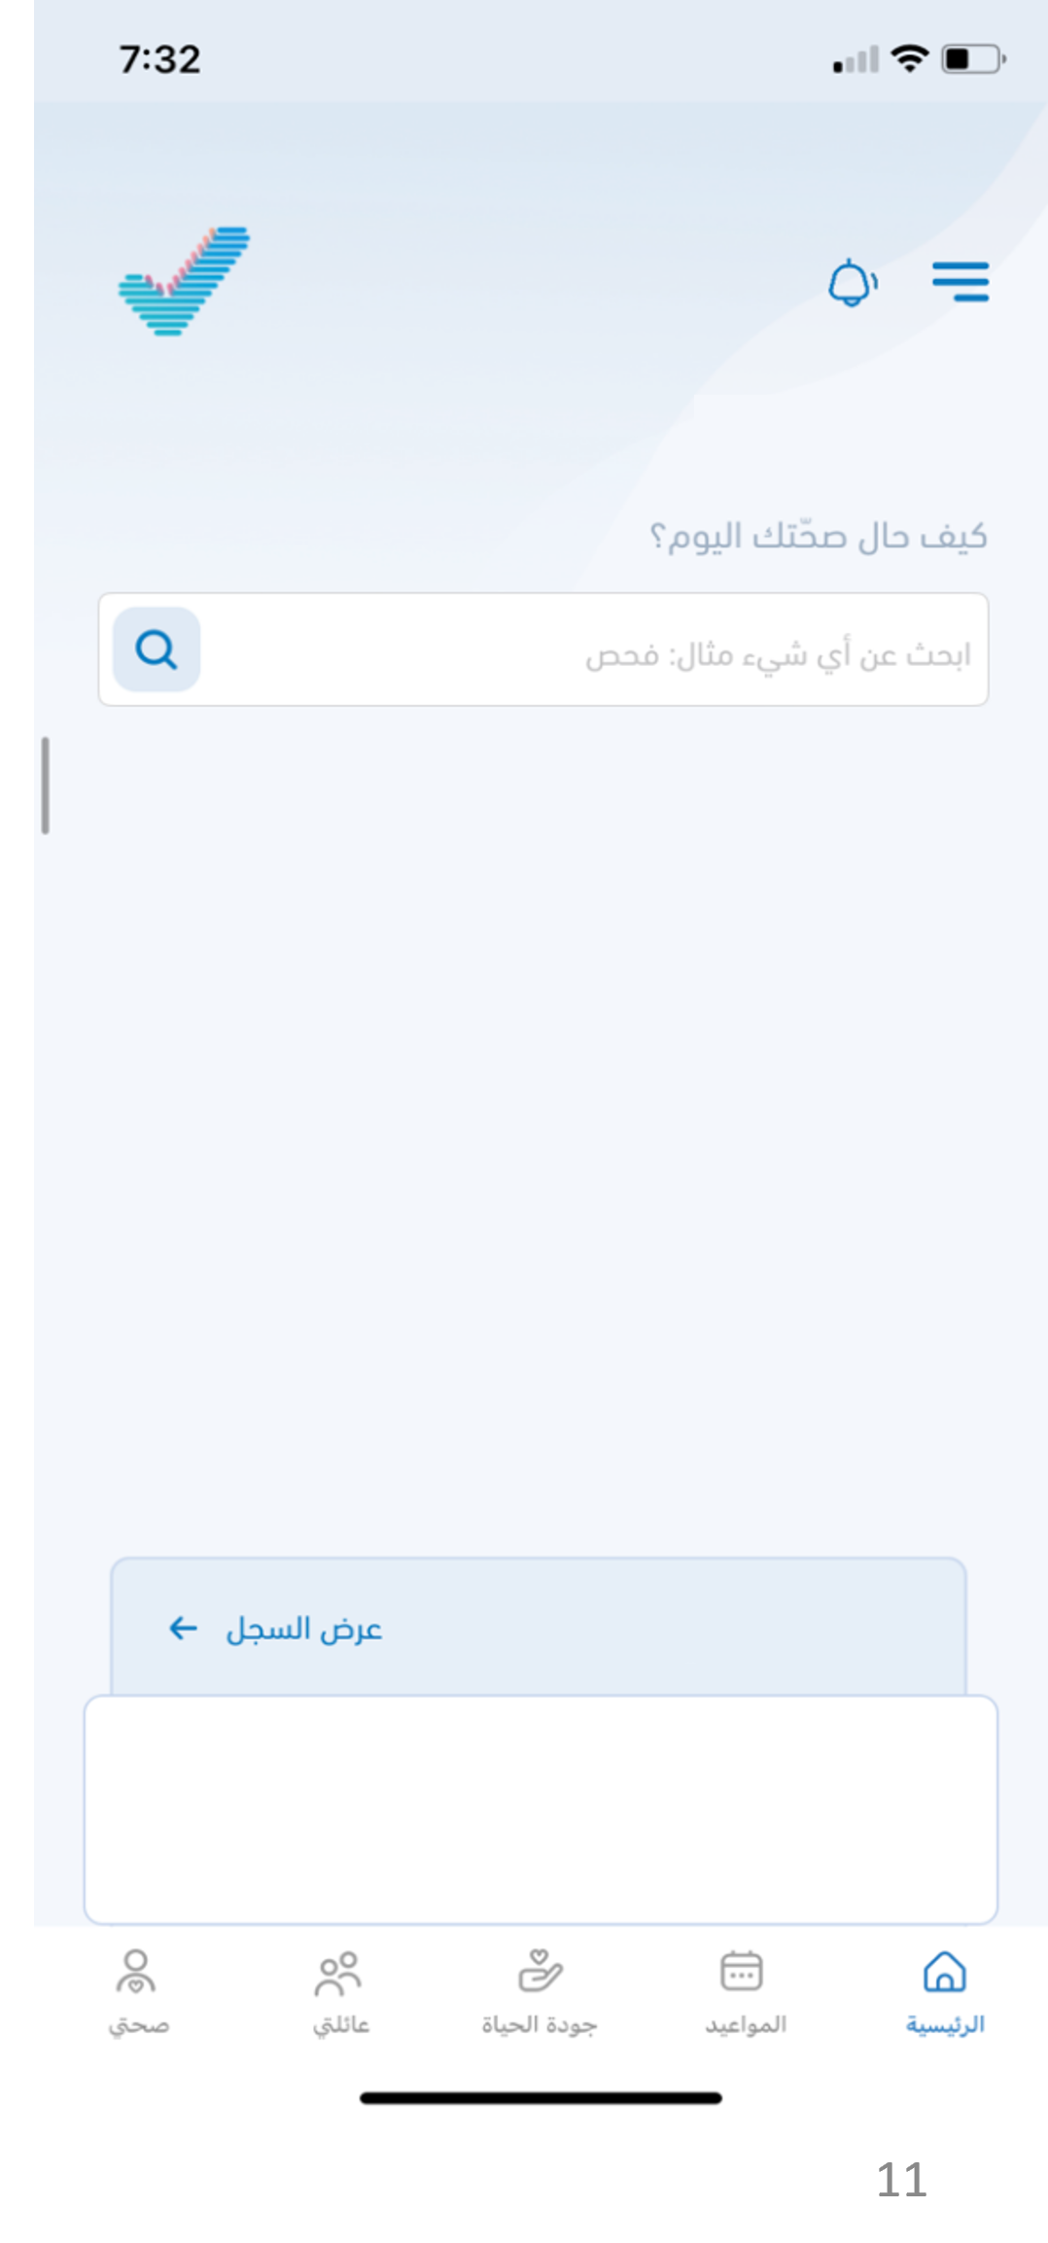
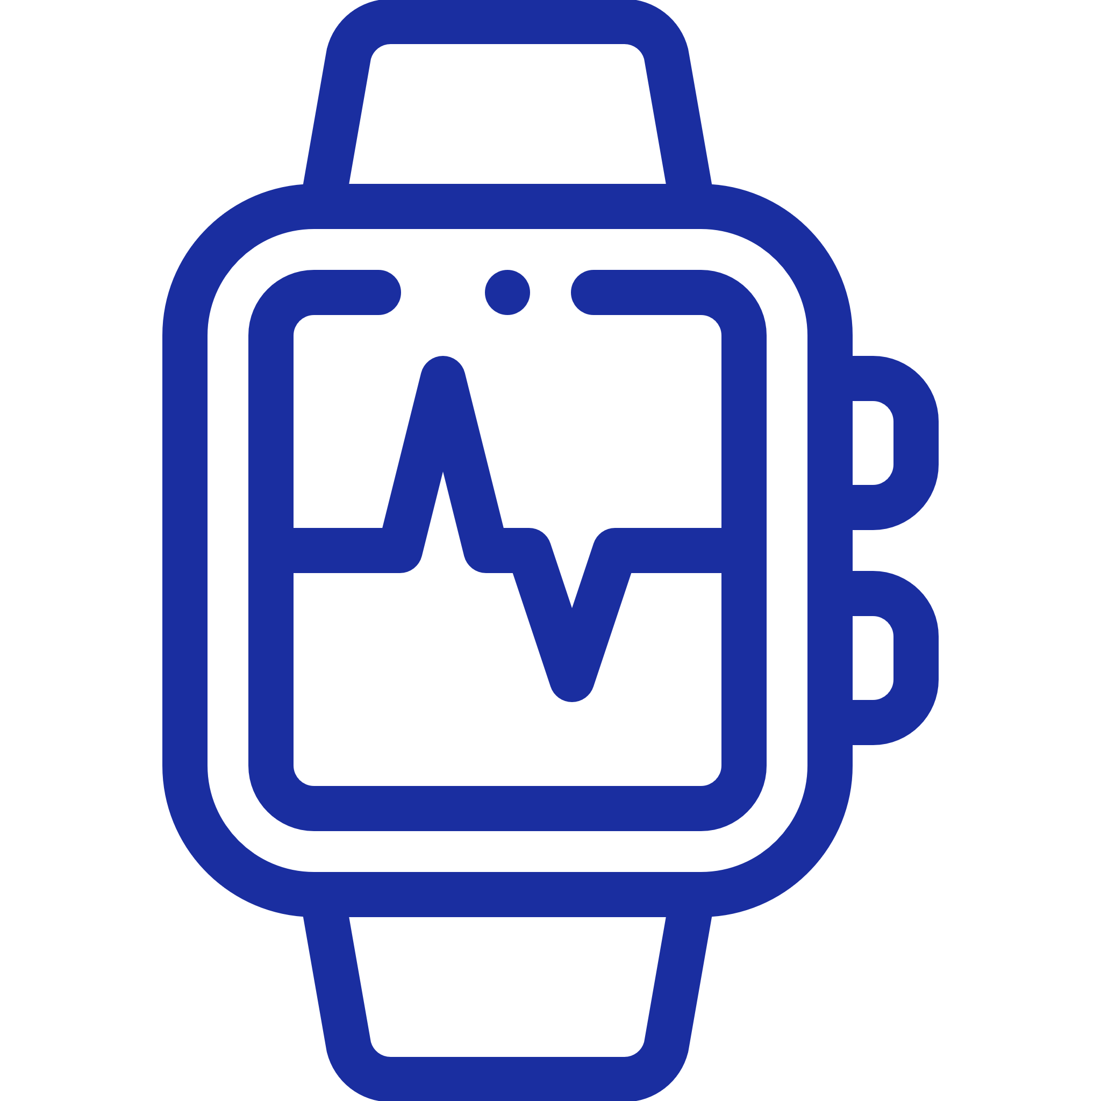

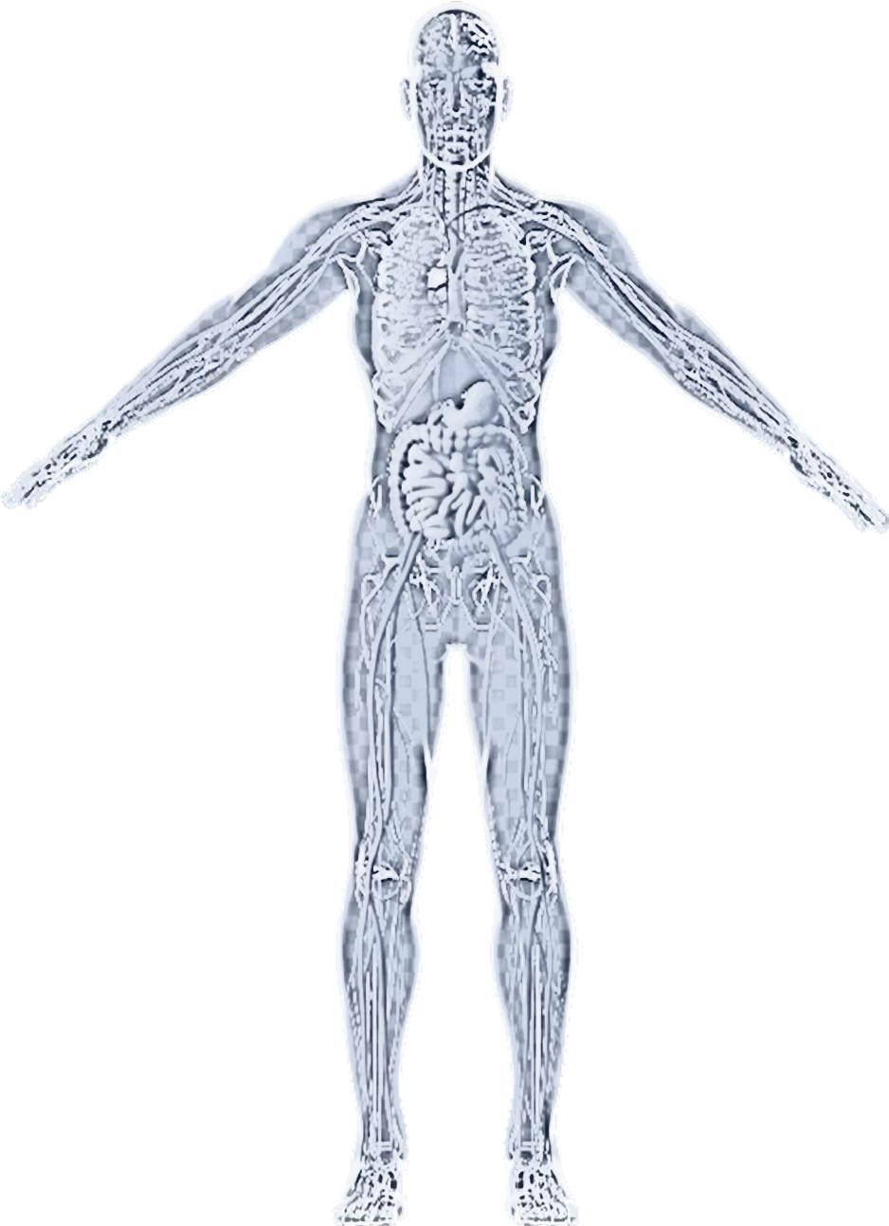

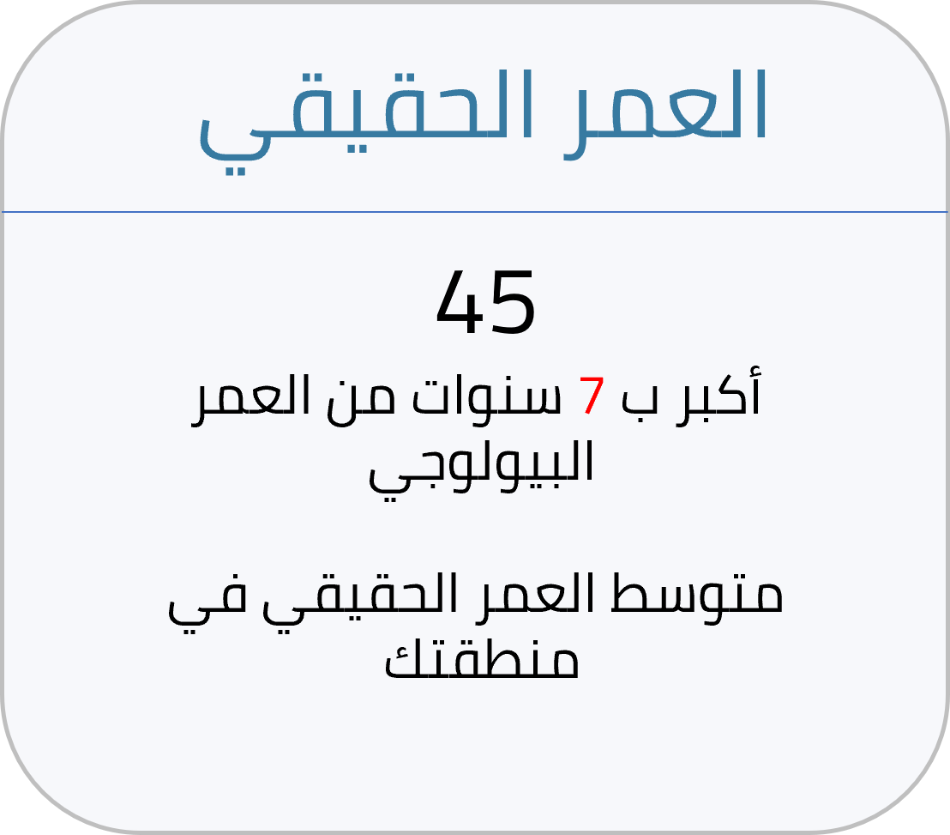
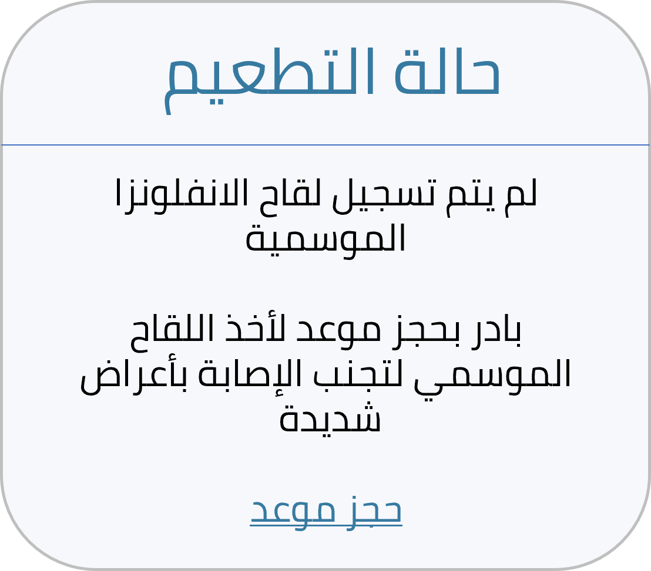


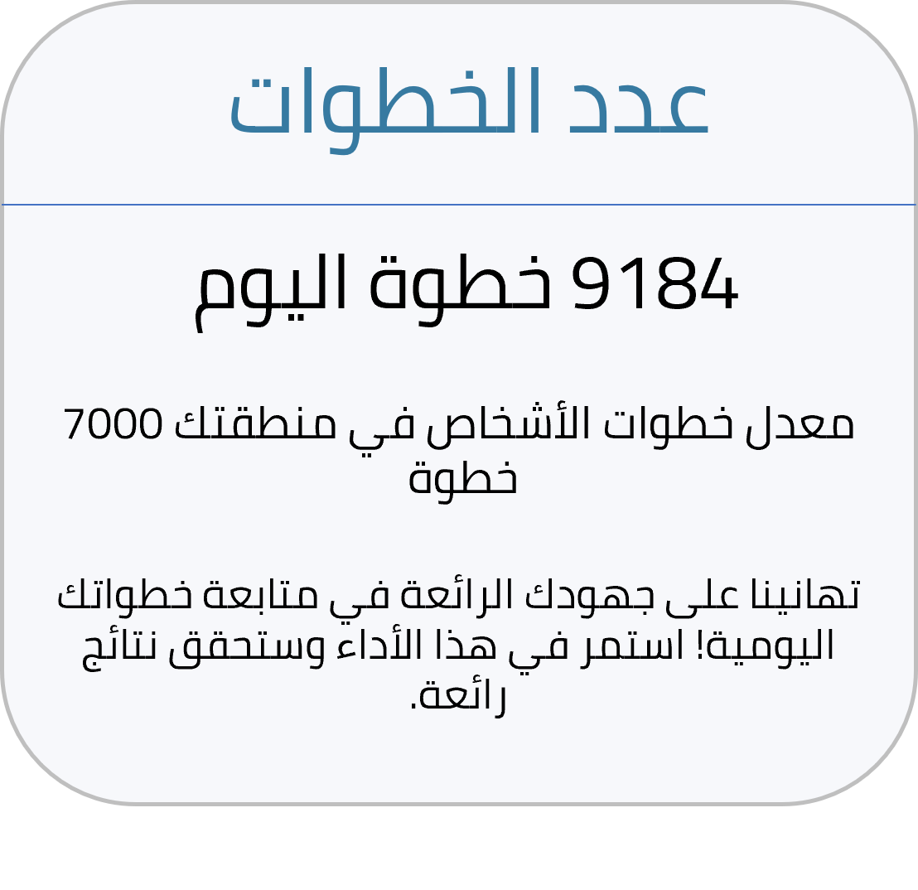

Digital Twin
The Real Individual
Individual’s Digital Twin View
Digital Twin Core
Data Source
Feedback
Analysis
Patient data from various sources
IoT sensors
Data is analyzed through AI models.
Patients Data
Wearables & IoT
Analytical Layer
Actions
Personalized content
Improved health outcomes
Recommendations & actions.
Identification and filtration
Predictive and simulation models
Virtual Layer
Improved Quality of life
Patient Empowered through personalized care
Medical Knowledge Bank

Slide 6



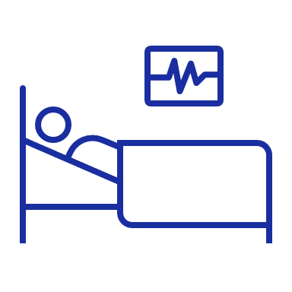

Digital Twin: The Future Optimal Future Impact
The digital twin application will achieve multiple future concepts in the following areas:
Scope of Care
Point of Care
Delivery of Care
System Focus
Engagement model
From sickness to prevention
From medical and reactive to holistic and proactive
From hospitals clinics and labs to a setting closer to the person
From standardized transactional care to personalized ‘always 'on’ care
From treatment to
coaching and guiding
Source:
10-15 Year Vision for the Future of Public Healthcare in a technology enabled 21st Century Wilkins, Andy (2019)
Men represented 55% of the total identified
73% of those identified were over 50 years old
Insights

Slide 7

Snapshots of Use cases
It aims to provide information that allows the user to take an active role in their own health care, with an emphasis on the role of preventive health.
Use cases leverage the digital twin to view some of the health indicators.

Slide 8
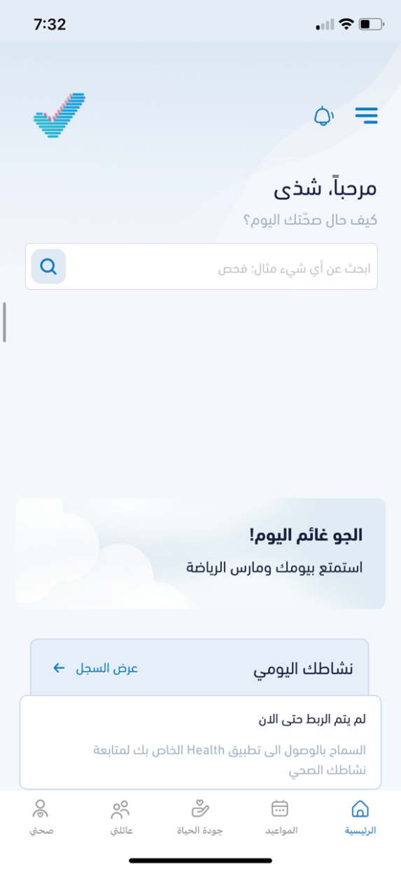
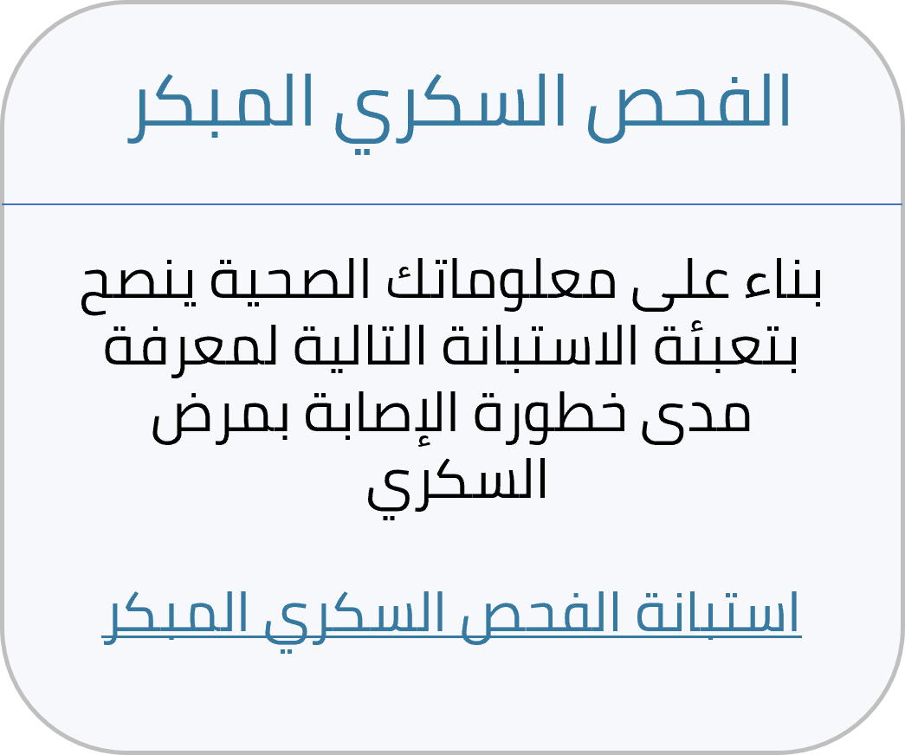

Use case 1: NCD Early Screening
Early detection of NCD by AI.
Description
Diabetes Early Screening
Individual fulfilling with screening criteria. (ex: for DM: more then 35 years, overweight and obese beside other risk factors)
Target group
Based on your clinical information we advised you to fill the diabetes risk questionnaire to identify your risk to have diabetes
Hello, Shatha
How’s your health today?
Early screening of Diabetes questionnaire
Interpretation of the result
Classifying the high risk based on the patient’s and family history and using AI.
Analyzing beneficiary data using AI model.
Patients consent
Availability of data
Availability of wearable devices
Technical literacy
Dependability
A
Asking the beneficiary to fill the diabetes risk questionnaire, then suggest to see a doctor if the risk is high. While if it is negative to send motivational response to continue healthy behavior.
Next Steps
A
Calculate the percentage of the patients who were recruited to digital twin versus patients who were not.
Measuring Impact

Slide 9
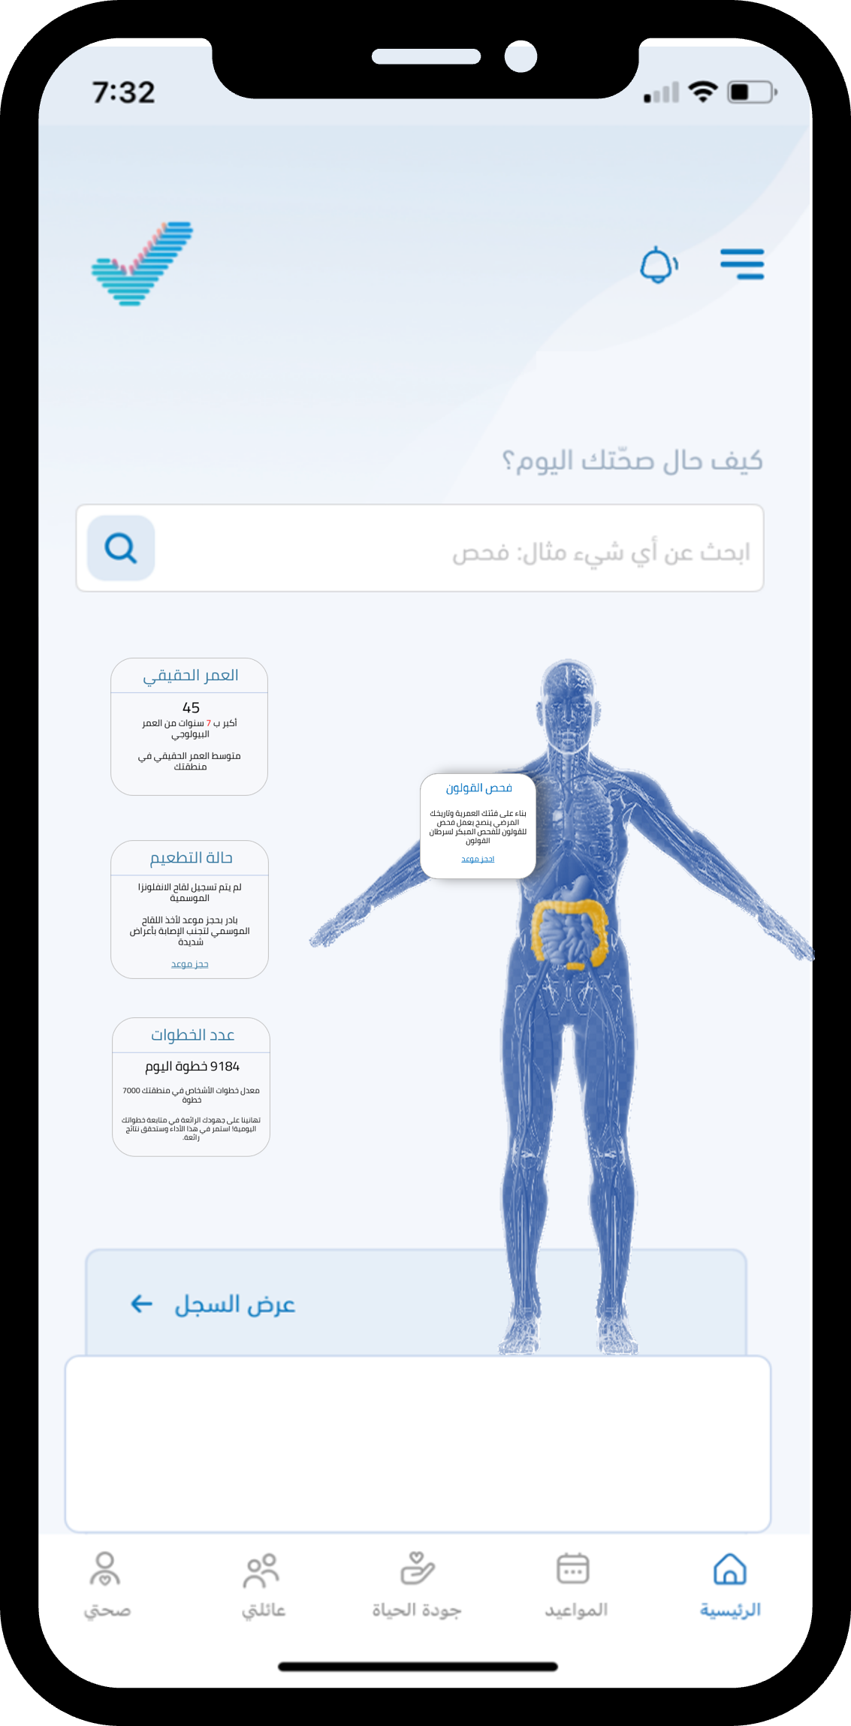
Use case 2: Colon Cancer Screening
Early detection of colon cancer
Description
Colon Cancer Screening
Based on your age group and your medical history, we advise you to screen for colon cancer
Target group
More then 45 years, and people with family (i.e., inherited cancer gene mutation ex: MLH1).
Book an appointment
Hello, Shatha
How’s your health today?
Interpretation of the result
Aging medical history at individual and family history.
Dependability
Date of birth, individual and family history, race, ethnicity.
Analyzing beneficiary data using AI model.
Patients consent
Availability of data
Next Steps
Book an appointment in the primary health care center.
Impact
Calculate the percentage of the patients who were recruited to digital twin versus patients who were not

Slide 10





Digital Twins benefits several stakeholders
PAYERS
PROVIDERS
REGULATORS
SUPPORTING
SERVICES
Individuals

Slide 11
Thank you

Slide 12



Four Reasons Why We Should Win This Fabulous Award
Novelty
Saudi Workforce
Real Application
Tangible Impact
This is the first initiative of its kind and scale in Saudi Arabia to adopt the digital twin concept in health care.
The entire project is built by Saudi engineers and data scientists and clinicians.
In collaboration with the Ministry of health, we applied the AI- assisted diabetic screening on a national level on 7.7 M residents in Saudi Arabia (fitting the inclusion –exclusion criteria).
The initial model estimates showed that 19,220 individual are at high risk of having diabetes or prediabetic.

Slide 13


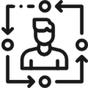



Digital Twin 1.0:The Pilot study- The protocol
We applied an AI-assisted model to identify the probability of having diabetes or prediabetes
Diabetes screening protocol
Predictive detection model for diabetes
Probability diabetes or prediabetes
Send questionnaire to assess situation and risks
Review form result and communicate to make decision
Contact with beneficiary
Patient data
Age and gender
Weight and height
Chronic diseases
Medical procedures
Use an AI model to predict:
Review data and treatment decision make
Beneficiaries of 3 PHC were assessed using AI for likelihood of having diabetes or prediabetes based on individuals' information.
AI model produced a probability score (risk score) of likelihood to have diabetes or prediabetes based.
ADA risk assessment (Arabic version) Questionnaire was sent to 3400 individuals (representative).
Patients with a high survey score will receive SMS message to book an appointment in Sehhaty app
Doctors at the participating centers were instructed to take a cumulative diabetes (HbA1c) test and enter results into the HIS.

Slide 14




Digital Twin 1.0: AI Early Detection of Diabetes– Model Build
The AI model was built to predict people at risk of having diabetes type 2 using iterative approach .
Data Collection
Data Processing
Building ML model
Model Selection
Data Source:
Primary healthcare center’s HIS
Date of data
collection:
2017- present
Sample Number:
~7 Million
This include
(but not limited to):
Four algorithms were compared:
Logistic regression was selected
Quality checking
Feature engineering
Data restructuring
Labels encoding
Balance rating
Logistic regression
Random forest
Linear SVC
Decision Tree
Logistic Regression model was the most accurate model in training/testing phase.

Slide 15
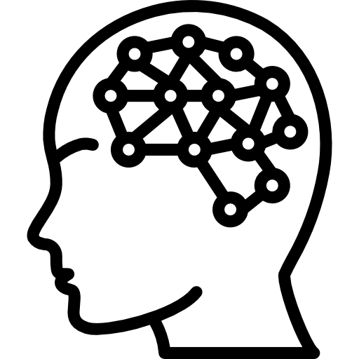



Digital Twin 1.0: The Project Overview
Objective: To build and validate an AI-assisted diabetic screening protocol (IRB 23-31 M).
Methods: The pilot study was conducted on 3 Primary healthcare centers (PHC). All participants were given a diabetes risk score and asked to fill ADA risk assessment questionnaire. High risk participants were asked to take HbA1C at one of the participating PHCs.
Build A Predictive Model
Individuals Communicated
High Risk Identified
Results
AI model was built for early detection of diabetes
3400 Individuals were randomly selected to receive ADA risk assessment
864 Responded
282 individuals scored 5 and above and were asked to schedule an appointment through Sehhaty
90 individuals took HbA1C test.
52% were prediabetic and 7% were diabetic

Slide 16
Digital Twin 1.0: The Pilot study- Sample and Results
9,400 who met the study conditions had been identified
3,400 people were randomly –but representatively
In High-Risk probability group: HbA1C test results show that 56% of those who have taken the HbA1C test are either diabetic of prediabetic patients
Sample size and distribution
Respondents
Already have diabetes
Risk of diabetes
HbA1C test
High Risk probability
714
Have diabetes: 181
Low Risk probability
Diagnosed with diabetes: 6
35
220
2606
Diagnosed with prediabetes: 47
High probability: 282 (we followed 220)
⁴⁶⁸
Sample size:
3400
62
No diabetes: 37
Did the test: 90
101
794
299
Low probability: 400
³⁹⁶
AI model result
Size of the response on questionnaire
Questionnaire result
Test result

Slide 17
Digital Twin 1.0: The Model Performance Assessment
Accuracy was over 78% in the high-risk category compared to 25% for low-risk category.
The difference in probability of having diabetes or prediabetes between the two categories is 3x
High risk (> 50%) | Low risk (< 50%)
846 | 396
31% | 9%
47% | 16%
22% | 75%
Filled questionnaire
Previously diagnosed with diabetes
High risk of having diabetes
Low risk of having diabetes

Slide 18
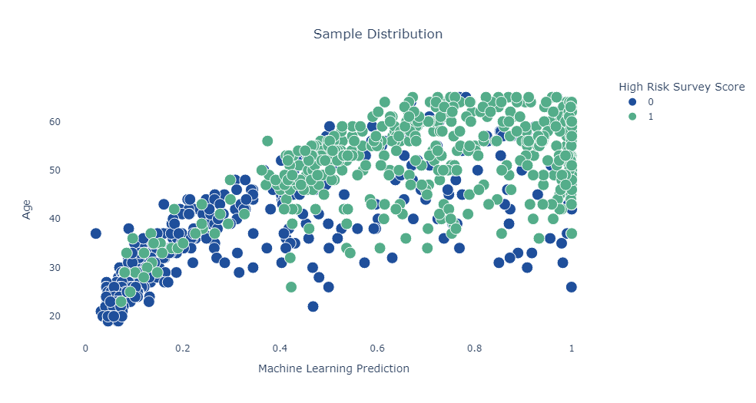
Digital Twin 1.0: Compatibility Between AI Model Results And ADA Questionnaire Result By Age.
The (Youden's index) was used to measure the performance of the model compared to the outcome of the questionnaire
The model achieved score of 53% and a sensitivity, specificity of 77.9% and 75.1%, respectively.
Distribution Of The Sample Based On The Age Group And The Agreement Between The High Risk By The Model
And The Outcome Of The ADA Questionnaire
ADA score is less than 5
ADA score 5 and more or previously diagnosed with diabetes

Slide 19
Digital Twin 1.0: The AI Model Identified The People With A High Probability Of Developing Diabetes Or Its Precursors.
The model’s accuracy reached more than 78% in identifying people with diabetes or those with a high probability of developing it*
% At high risk or had the disease
0%
0%
55%
19%
73%
73%
86%
74%
96%
90%
466
Male
Submitted the survey
Female
Number Of People At High Risk
Target population in study
31%
Previously diagnosed as Diabetic
Achieved a high score in the ADA screening questionnaire ☨
47%
Age
*The total percentage of those who indicated their previous diagnosis of diabetes or achieved a high score in the prediabetes. ☨ screening questionnaire achieved five points or more according to the recommendations of the American Center for Disease Prevention (CDC)
local and international studies recommend screening those over 35 years old
Men represented 55% of the total identified
73% of those identified were over 50 years old
Insights

Slide 20
Use case 2: The Real Age
The Real Age
Show the real age of the individual
Description
45
7 years older than your biological age, the real average age in your area.
Early screening of Diabets questionnaire
Hello, Shatha
How’s your health today?
Target group
More then 30 years.
The Real Age
45
7 years older than your biological age, the real average age in your area
Interpretation of the result
The reason for the increase or decrease in real age, for example: an increase in body mass index
Dependability
Global burden of disease GBD
Motivating the individual to improve the reasons for the increase in real age mentioned in the interpretation of the result
Next Steps

Slide 21
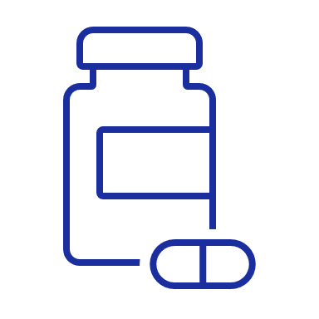
Supply Chain
Risk Alarm
Ecosystem
Digital Twin
Monitoring System
Induvial Patients
Mental Health
Data Source
Genomics

Slide 22




Four Reasons Why We Should Win This Fabulous Award
Novelty
Saudi Workforce
Real application
Tangible Impact
This is the first initiative of its kind and scale in Saudi Arabia to adopt the digital twin concept in health care.
The entire project is built by Saudi engineers and data scientists and clinicians.
In collaboration with the Ministry of health, we applied the AI- assisted diabetic screening on a national level on 7.7 M residents in Saudi Arabia (fitting the inclusion –exclusion criteria).
The initial model estimates showed that 19,220 individual are at high risk of having diabetes or prediabetic.
Men represented 55% of the total identified
73% of those identified were over 50 years old
Insights

